Slide 1
19: Isosurfaces & Distance Fields

Slide 2
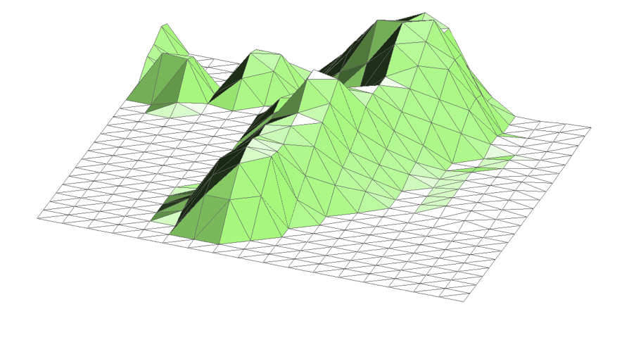
$f:ℝ^{2}→ℝ$: Height Field
For every point in the plane, define a height
The graph is then a terrain
i.e. a surface in a 3D embedding space

Slide 3
Contours
We can define curves using contours
Let an artist design the landscape
Pick a threshold, generate a curve

Slide 4
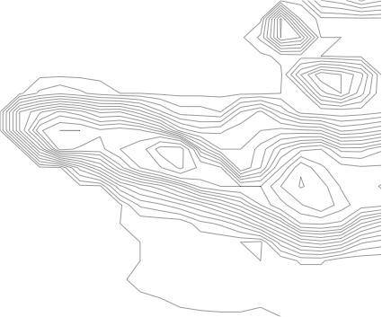
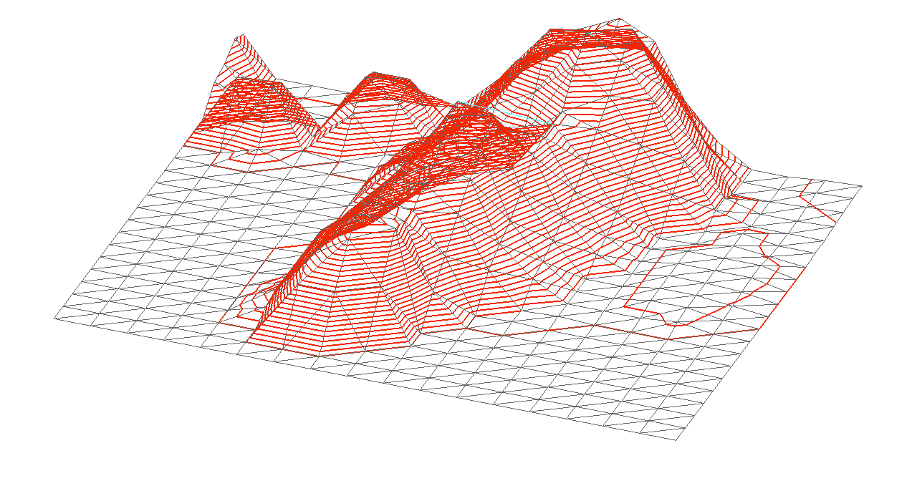
Manifold Dimension
f is a 2-manifold embedded in 3-D
It's contours are 1-manifolds
embedded in 2-D
or in 3-D
What happens if we add a dimension?

Slide 5
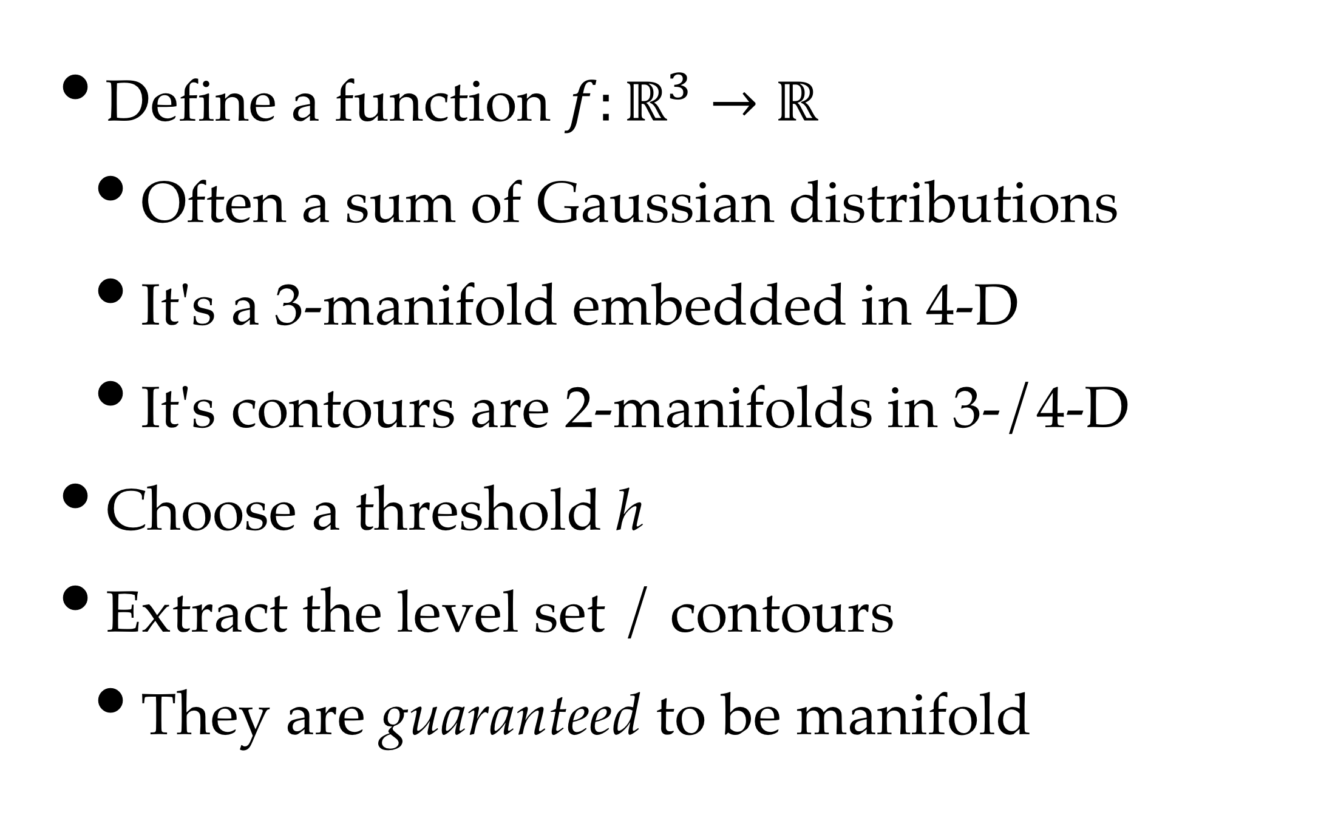
Implicit (Blobby) Surfaces
Define a function $f:ℝ^{3}→ℝ$
Often a sum of Gaussian distributions
It's a 3-manifold embedded in 4-D
It's contours are 2-manifolds in 3-/4-D
Choose a threshold h
Extract the level set / contours
They are guaranteed to be manifold

Slide 6
Isosurfaces
Contours in 3D
Based on the inverse image of and isovalue
2-manifolds embedded in 3 or 4 space
We can usually only show one isosurface
because they occlude each other

Slide 7
Implicit (Blobby) Surfaces
Wyvill, McPheeters & Wyvill, 1986

Slide 8
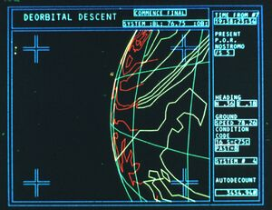
Bonus Points: Alien (1979)

Slide 9
Implicit Surfaces
We can use many types of functions:
CT/MRI scans
Numerical simulations
Mathematical models – eg. sum of Gaussians
Distance fields
any property we can compute in 3-D
In practice, we need to start with a 3-D mesh

Slide 10
Meshes in 3D
In 2-D, we use triangles and squares
In 3-D, we use tetrahedra and cubes
also pyramids, octahedra & triangular prisms
Interpolation follows the same rules as in 2-D
geometric interpolation (meshes)
kernel filters (sampling theory)

Slide 11
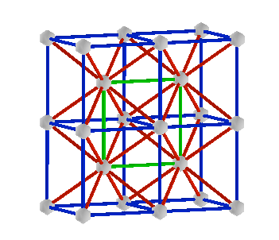
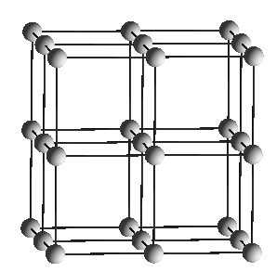

Mesh Construction
Two common types of mesh:
Tetrahedral, either arbitrary or subdivided
Cubic – basically, a 3D array in memory

Slide 12
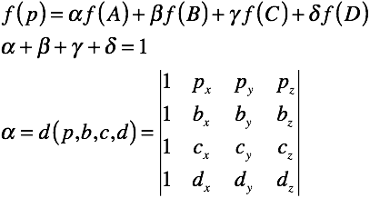
Barycentric Interpolation
Linear interpolation based on distances
Extend by using distance to faces
Applied in each tetrahedron

Slide 13
Trilinear Interpolation
Repeat linear interpolation in 3 dimensions
Used for cubic meshes

Slide 14
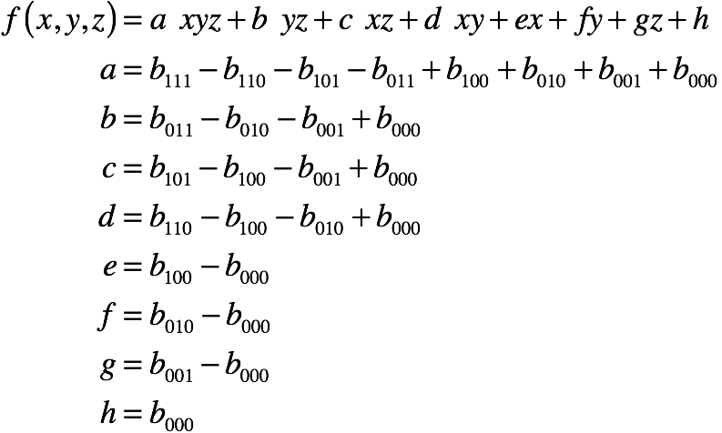
Trilinear Interpolation

Slide 15
Marching Cells
A class of algorithms that extract contours
Given a mesh made of cells
triangles, squares, tetrahedra, cubes, &c.
Iterate (march) through each cell
Extract the part of the mesh in the cell
Produces triangle soup
Sort out connectivity, &c. afterwards

Slide 16
Marching Tetrahedra
Classify vertices black / white
Interpolate points along edges
Connect with simplices - in 3-D, triangles
Any surface generated is flat (even quad in 2)

Slide 17
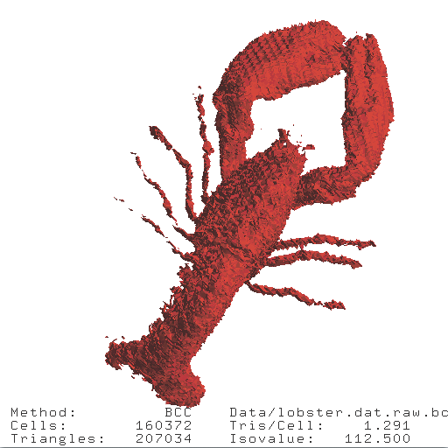
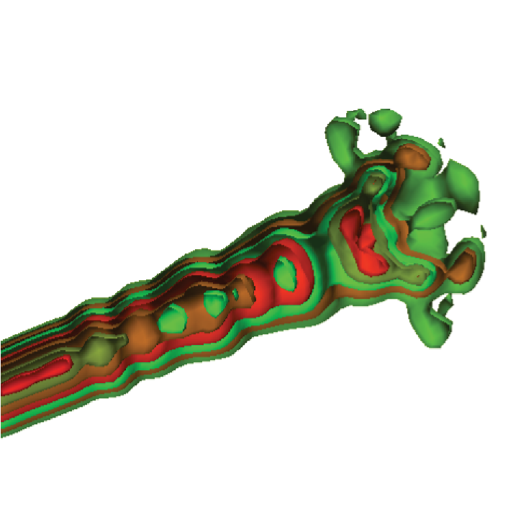
Result

Slide 18
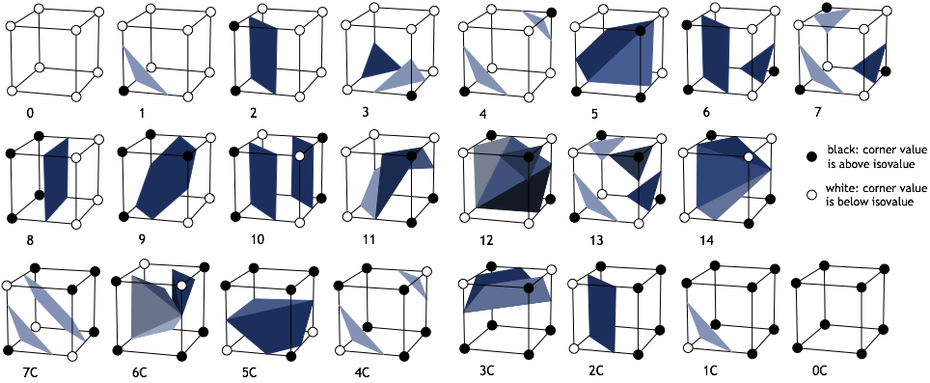
Marching Cubes

Slide 19
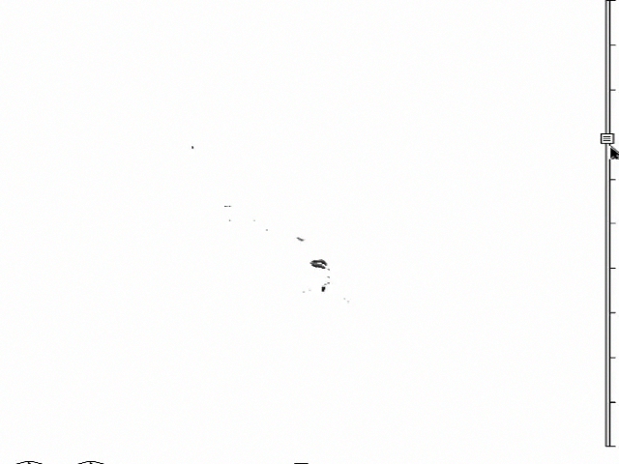
An Example

Slide 20
Trilinear Tessellation
Lorenson & Cline, 1987 (Marching Cubes)
Wyvill, McPheeters & Wyvill, 1987 (Soft Objects)
Dürst, 1988 (cracks in Marching Cubes)
Wilhelms & van Gelder, 1990, (simplicial subdivision)
Matveyev, 1994, Montani, Scateni & Scopigno, 1994 (modified MC tables)
Nielson & Hamann, 1991 (Asymptotic Decider - bilinear saddles on faces)
Natarajan, 1994 (Extension of Asymptotic Decider - trilinear body saddle)
Cignoni, Ganovelli, Montani, & Scopigno, 2000 (Natarajan's solution)
Pascucci (& others?), 2002 (also 2 body saddles)
Nielson, 2003 (full set of cases)
Lopes & Brodlie, 2003 (optimal placement of vertices)
Carr (& Max) 2007/8 (alternate proof)

Slide 21
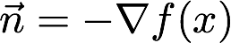
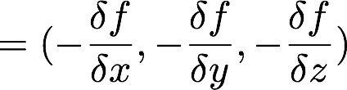
Computing Normal
Normal vector is based on gradient
always perpendicular to contours
describes steepest ascent
but outside is typically low-valued
use negative gradient as normal

Slide 22
Central Differencing:
Approximation of gradient:
Compute at vertices of cell
Interpolate along edges

Slide 23
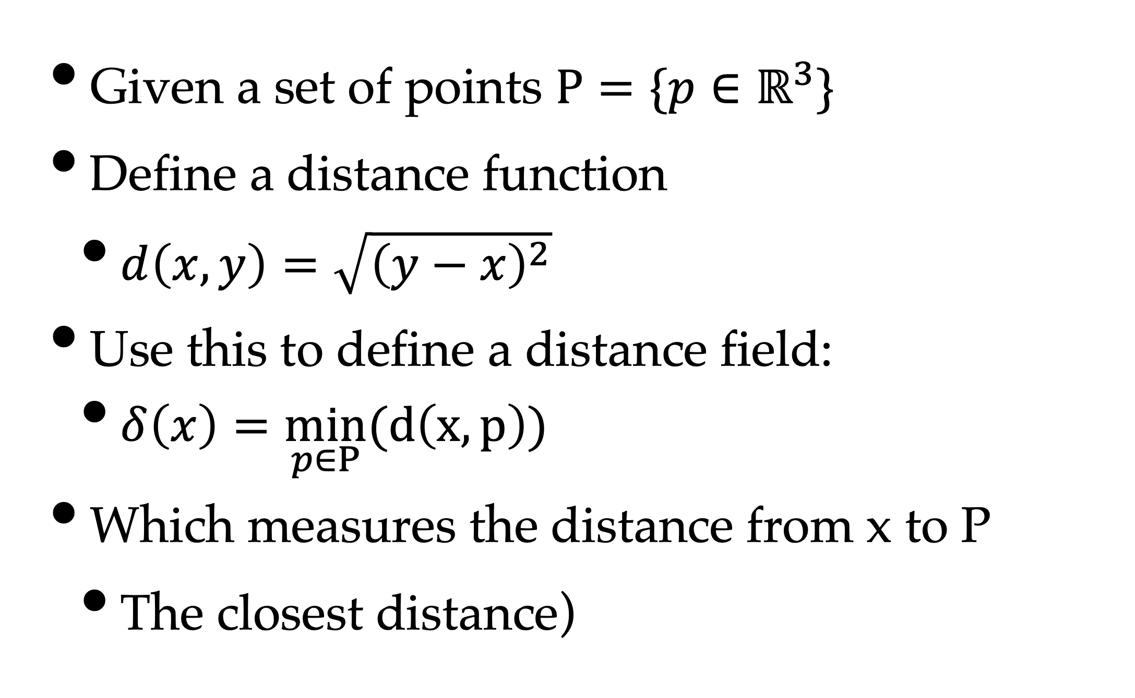
Distance Fields
Given a set of points $P=\{p∈ℝ^{3}\}$
Define a distance function
$d\left(x,y\right)=\sqrt{{\left(y−x\right)}^{2}}$
Use this to define a distance field:
$δ\left(x\right)=\min_{p∈P}(d\left(x,p\right))$
Which measures the distance from x to P
The closest distance)

Slide 24
Possibilities
Explicit list of points
Generic set (infinitely many)
Set of lines
Set of triangles
Arbitrary surface

Slide 25
An Example

Slide 26
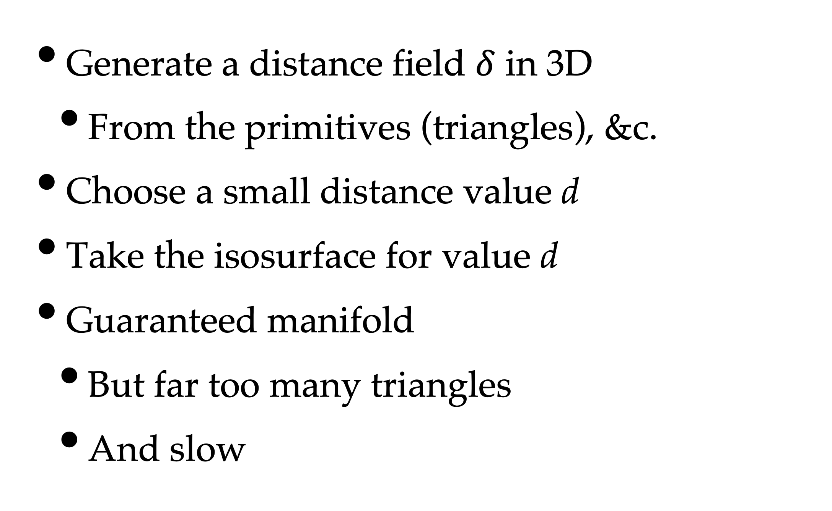
Volumetric Mesh Repair
Generate a distance field $δ$ in 3D
From the primitives (triangles), &c.
Choose a small distance value d
Take the isosurface for value d
Guaranteed manifold
But far too many triangles
And slow

